Slide 1
Cloud Networking

Slide 2
Lots of Hosts
Lots of Switches
NAT
Load balancing
WAN optiomization
Firewall
Specialized communication protocol

Slide 3
Software defined network
Seperation of control plane from data forwarding plane
Platform is decoupled from infrastructure
Centralized controller, network wide control by controller Software that performs routing and traffic engineering

Slide 4
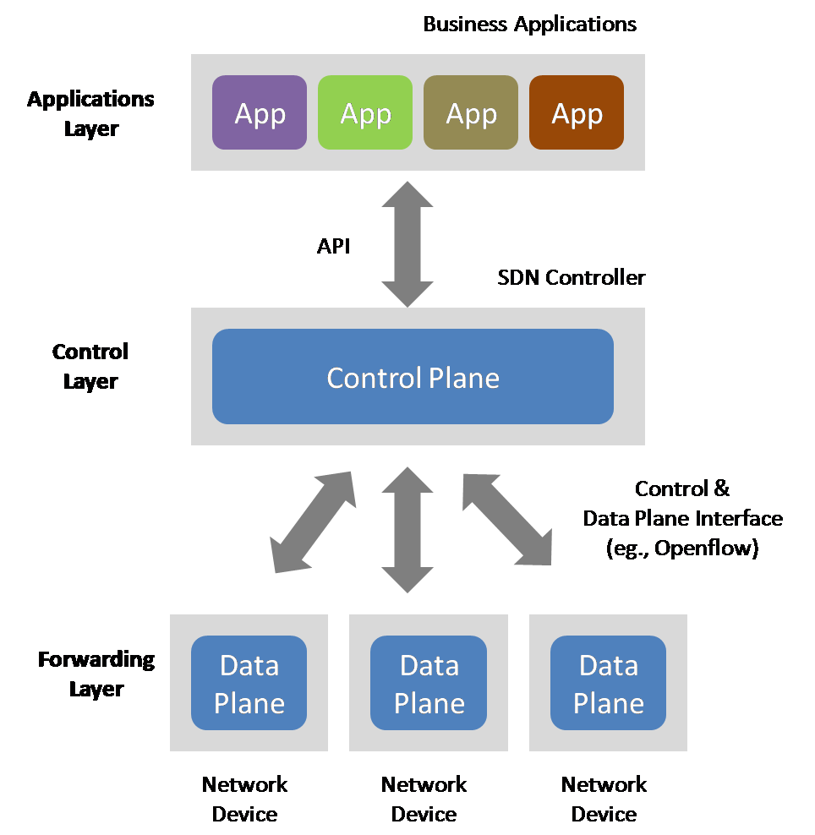

Slide 5
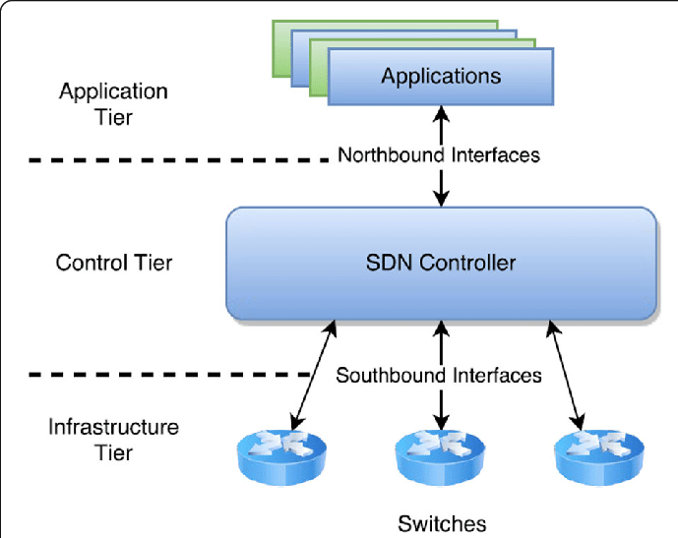

Slide 6
Dynamic configuration of networking
Real time responsiveness
Network can be programmed
Load balancing

Slide 7
Network Function Virtualization
NFV is the decoupling of network functions from proprietary hardware appliances and running them as software in virtual machine
Migration of network functions to application layer
Allows interoperability of equipments and more advanced network functions

Slide 8
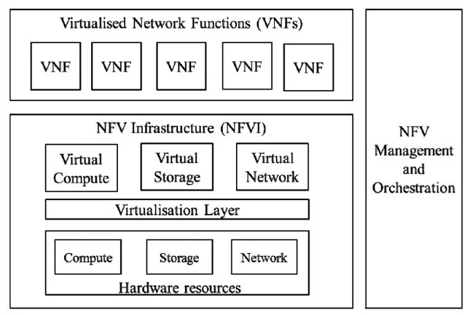

Slide 9
SDN vs NFV
SDN refers to a network architecture that injects automation and programmability into the network by decoupling network control and forwarding functions.
NFV refers to the virtualization of network component. NFV virtualizes network infrastructure and SDN centralizes network control.
The controller allows network administrators to view the network and dictate behaviors and policies to the underlying infrastructure.

Slide 10
Less Vender Lock in
Greater Efficiency
Flexibility

